Slide 1



PROJECT 3
TECHNICAL SEO AUDIT AND OPTIMIZATION
BY KRISH RANA

Slide 2

Project - 3
Introduction
TECHNICAL SEO AUDIT AND OPTIMIZATION
MyCaptain is an online learning platform offering career-oriented courses
Technical SEO ensures that a website is crawlable, indexable, and fast
A technical audit was conducted to identify issues affecting search performance and user experience

Slide 3
Project - 3
Our Objectives
Improve website speed and performance
Fix crawl errors and indexing issues
Ensure mobile-friendliness
Optimize technical elements for better search engine rankings

Slide 4
Project - 3
Techniques Used
Website Speed Analysis
Checked loading time using PageSpeed tools
Identified heavy images and scripts
Mobile Responsiveness Check
Tested mobile compatibility across pages
Used ubersuggest

Slide 5
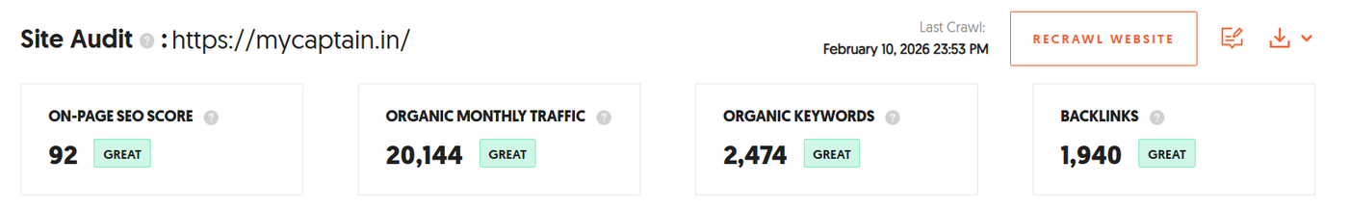
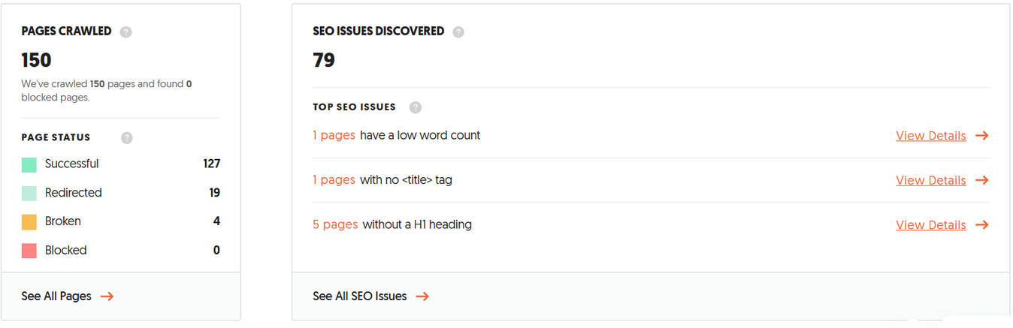
Project - 3
Technical SEO Audit

Slide 6
Project - 3
Issues (Ubersuggest)
Slow page speed due to heavy images
Large DOM size from repeated sections
Missing structured data (schema)
Lack of clear sitemap visibility
Heavy JavaScript affecting performance

Slide 7
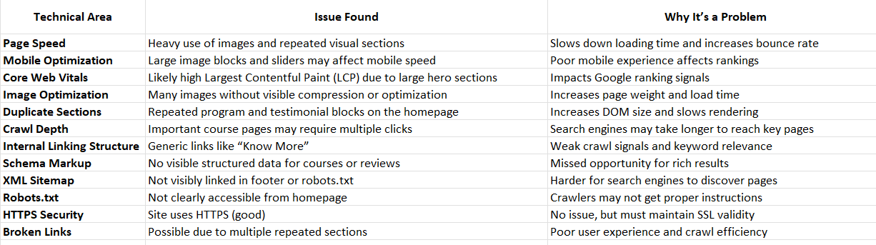
Project - 3
Issues (Ubersuggest)

Slide 8
Project - 3
Solutions
Compress images and convert them to WebP format.
Minify and defer CSS/JavaScript files.
Remove duplicate homepage sections.
Add schema markup for courses and reviews.
Create and submit an XML sitemap to Google Search Console.

Slide 9
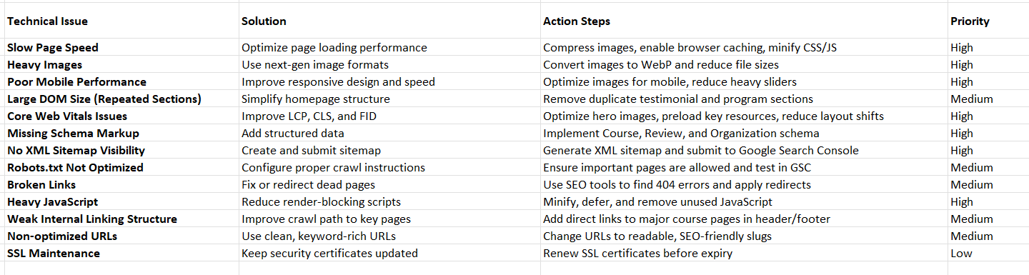
Project - 3
Solutions

Slide 10
Project - 3
Conclusion
The technical SEO audit of the MyCaptain website indicates that the site has a modern design and secure HTTPS setup, but several technical factors are limiting its search engine performance. Key issues include slow page speed due to heavy images, large DOM size from repeated sections, missing structured data, and the lack of a clearly accessible XML sitemap.
These technical problems can affect how efficiently search engines crawl, index, and rank the website, which may lead to lower organic visibility and traffic. By implementing the recommended solutions—such as optimizing images, improving Core Web Vitals, reducing unnecessary JavaScript, adding schema markup, and creating a proper sitemap—the site can achieve better performance and search rankings.
Overall, with focused technical improvements, MyCaptain can enhance its website speed, crawlability, and indexability, resulting in a stronger technical foundation for long-term SEO growth.

